Slide 1
Artemis (RACE) position validation & CFTC 204 data submission
Introduction of Microsoft Flow tool
July 13, 2022

Slide 2
Artemis Position Validation & CFTC 204 Data Submission
To support, facilitate and record the validation of Artemis position as well as CFTC 204 data submission, we will deploy a Microsoft Flow (Power Automate) for each business going Live on Artemis.
What is Microsoft Flow:
Microsoft Flow is a tool which allows the creation and automation of workflows/tasks.
How does it work:
Each business will have a flow and will include different tasks/steps for various roles.
A user will need to complete a step indicating the outcome (a set of pre-defined answers).
Once the outcome has been selected by the user, the flow will automatically move to the second step involving a second user with a different task and outcome.

Slide 3
Artemis Position Validation & CFTC 204 Data Submission
How is it facilitating/supporting our process:
Each step date/time/output/comments are recorded
Records can be used for internal reporting (for DCC for example and for TPC KPIs)
Flows can be used to inform downstream Artemis data consumers (for Risk Engine for example)
Note:
Please note we are in the process of reviewing the entire validation process including the different steps of Microsoft Flow with TPC management and there will be upcoming changes.
However, in the interim we need all businesses live with Artemis to start using this flow for monitoring purposes.

Slide 4
How does the flow work :
We will start with simple flow & steps as follows:
Step 1 Flow kick off by Artemis support team confirming position data is available for TPC to check
Step 1 will trigger both Step 2 (on daily basis) and Step 3 (on Mondays only)
Step 2 Daily - TPC Position validation
Once Step 2 is completed it will trigger an email to Risk
Step 3 Monday only - TPC confirmation of CFTC 204 data submission as and where applicable
STEP 2. TPC
Daily Position validation
Email to Risk
STEP 1. Support trigger when position is available
STEP 3. CFTC 204 Submission

Slide 5
STEP 1. Support trigger when position is available
Step 1. RACE Support trigger
Performed by: Artemis support team
Task: As soon as Artemis data is available and Tableau position is refreshed
Artemis support team will trigger the flow
Trigger will automatically move the process flow to Step 2 and Step 3.

Slide 6
STEP 2. TPC
Daily Position validation
Email to Risk
Step 2. TPC position validation (Finance Position Reconciliation)
Performed by: TPC
Task: - Reconcile Artemis positions against ERP/Traders’ positions,
- Complete adjustments as needed using PACE,
- Finalize the flow by validating the Artemis positions
How: Identified TPC recipients will either receive an e-mail or a team approval request to perform the validation (see examples on next slide)
Expected Results (Pre-defined answers):
1. Approve - Position is correct (no or minor differences*)
*we are in the process of defining the threshold
2. Reject - Position is incorrect due to significant differences & Comments
Important:
Comments will be critical - will avoid managers / leads and Race team asking questions about rejection reasons
A ticket should be logged with Artemis Support team for any issue requiring a fix.
Once positions are approved or rejected, flow will trigger an e-mail to Business Risk tag confirming the status.

Slide 7
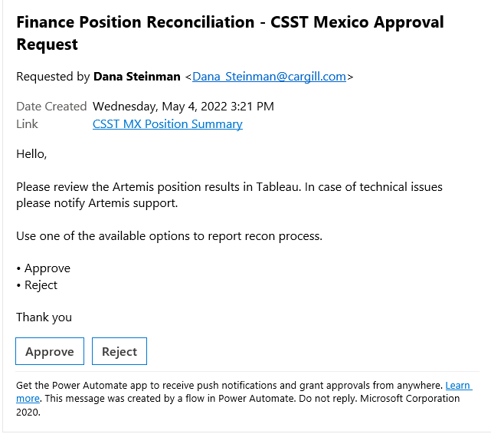
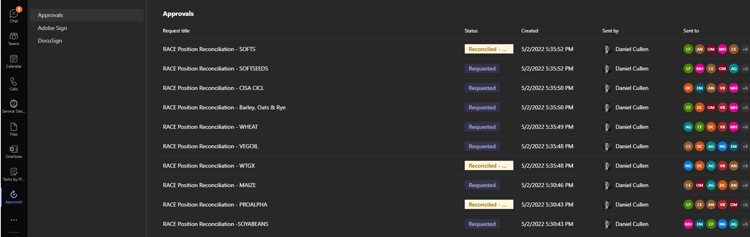
Email:
Link to Position Tableau report :
Pre-defined answers :
Approve
Reject
Buttons for each pre-defined answer :
Approve
Reject
Teams Approval:
Each approval file will have the exact same
content as email above.

Slide 8
STEP 3. CFTC 204 Submission
Step 3. CFTC 204 Data Submission
Performed by: TPC
Task: Check Artemis Tableau CFTC 204 position, adjust if needed and submit same to DCC
How: Identified TPC recipients will either receive an e-mail or a team approval request to perform the submission
Expected Results (Pre-defined answers):
1. Artemis 204 Report submitted
TPC is using Artemis Tableau CFTC 204 position report for submission
2. Legacy 204 Report submitted (please provide explanation)
TPC cannot use Artemis Tableau CFTC 204 position report for submission
Important: It is expected that once live on RACE, each business will use Artemis Tableau CFTC 204 positions to submit their CFTC 204 to DCC – if that cannot be done, we will need an explanation for same to address any issue we may have

Slide 9
What is needed from you to set up the flow:
Names of TPC resources involved in :
Position validation
CFTC 204 data submission
TPC resources:
=> Primary resource - owner
=> Secondary resource - back up
2. Flow communication: email or teams

